Slide 1
Conflict resolution educational program through collaborative learning for school teachers ITO, Takehiko (Wako University) SUGITA, Akihiro (Daito Bunka University) INOUE, Takayo (Meiji Gakuin University) TAKABE Yuko (Yokohama National University)

Slide 2
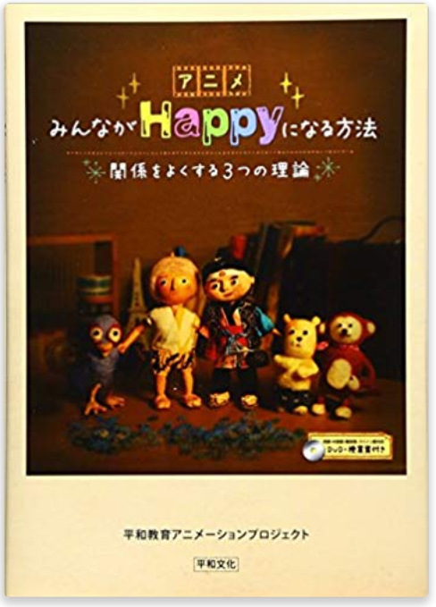
[Background]
We organized a conflict transformation program with animation movies
as a part of remedial course
for elementary and secondary teachers
to update their license.

Slide 3
［Aim］
The aim of the present study was to introduce and evaluate the program session by analyzing 47 participants’ visual works and their answers to open-end questions.
Female 25
Male 22
Elementary 18
Junior high 14
Senior high 14

Slide 4
[Methods]
The program consisted of four parts:
(1) lecture on concepts of violence and peace proposed by Johan Galtung,
(2) lecture and discussion on conflict by using two animation stories,
(3) analysis of conflict cases provided by participants, and
(4) collaborative group work by collectively constructing diagram of certain conflict case.

Slide 5
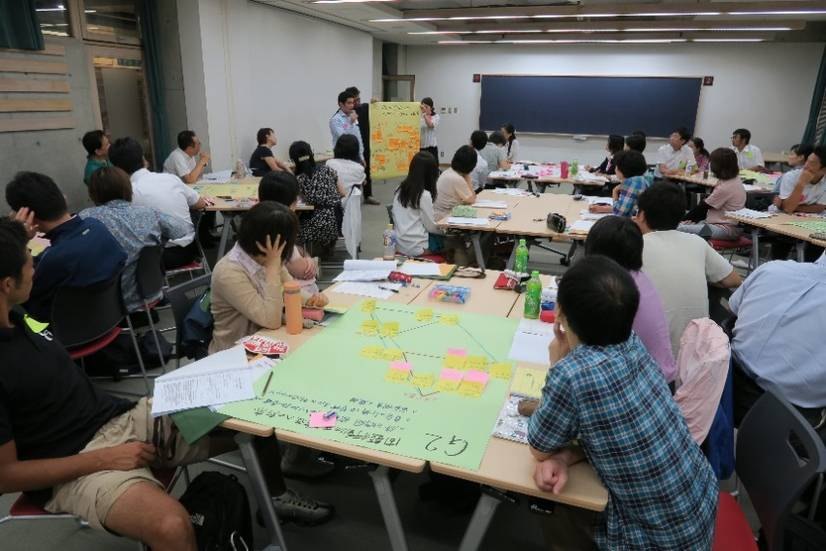
Presentation in the group work

Slide 6
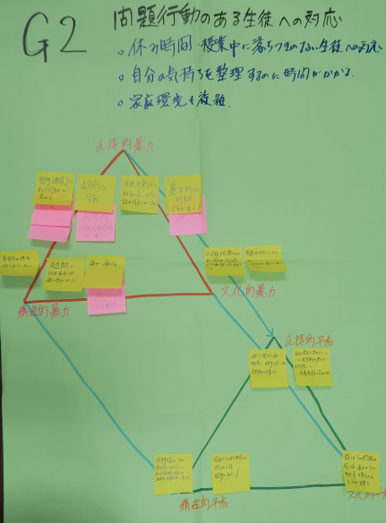
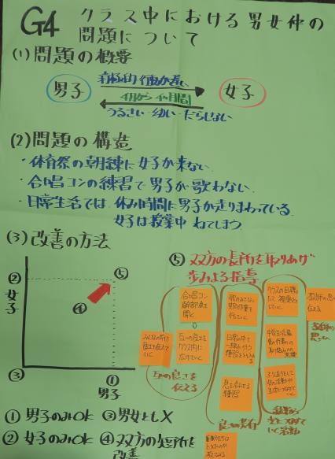
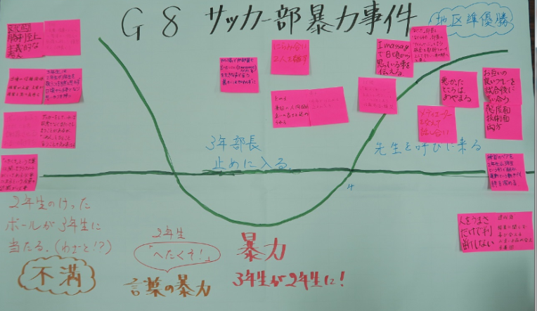
Diagrams by group work
Communication
with a pupil who
had problem behavior
Relation between
boy and girl students
In a classroom
Volent incidence
In a soccer club

Slide 7
[Results]
A text mining analysis was conducted to each of the questions on troubles, conflicts, the group work evaluation, usefulness of the program, and demand for a better program.
It revealed that the teachers had troubles/conflicts mostly about human relationships such as with “pupils”, “children”, “teachers” and “parents.”

Slide 8
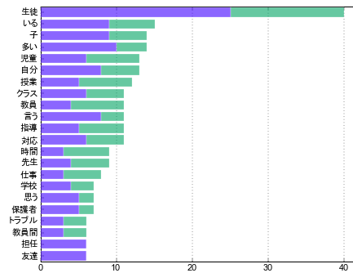
Q1 Troubles
Student
Being
Children
Many
Pupil
Self
Class
Classroom
Teachers
Say
Schooling
Coping
Time
Schoolteacher
Work
School
Think
Parents
Trouble
Among teachers
Homeroom teacher
Friends
(Left: female, Right: male)

Slide 9
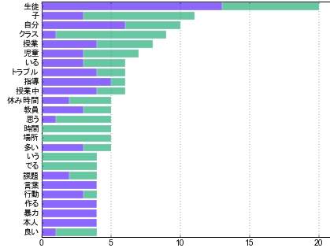
Q2 Conflicts
Student
Child
Self
Class
Lesson
Pupil
Being
Trouble
Instruction
Class time
Recess time
Teachers
Think
Time
Place
Many
Say
Emerge
Task
Words
Behavior
Make
Violence
Responsible person
Good
(Left: female, Right: male)

Slide 10
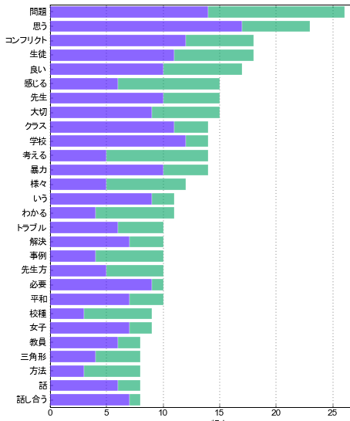
Q3 group work
Problem
Think
Conflict
Students
Good
Feel
Teacher
Important
Class
School
Think
Violence
Various
Say
Understand
Trouble
Resolution
Case
Schoolteachers
Necessary
Peace
School category
Girl student
Instructor
Triangle
Method
Talk
Communicate
(Left: female, Right: male)

Slide 11
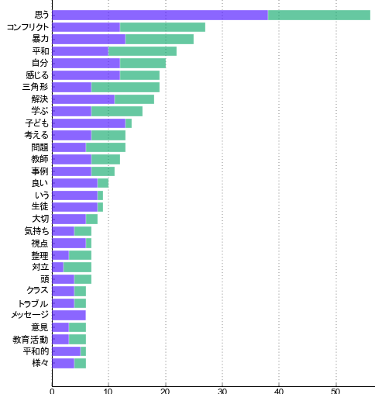
Q4 Utilization strategies
Think
Conflict
Violence
Peace
Self
Feel
Triangle
Resolution
Learn
Children
Think
Problem
Teacher
Case
Good
Say
Pupil
Important
Viewpoint
Arrangement
Conflict
Brain
Class
Trouble
Message
Opinion
Education activity
Peaceful
Various
(Left: female, Right: male)

Slide 12
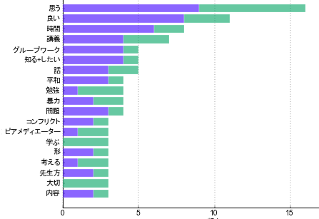
Q５ Demand for further workshop
Think
Good
Time
Lecture
Group work
Want to know
Talk
Peace
Learning
Violence
Problem
Conflict
Peer mediator
Learn
Figure
think]
Teachers
Important
Content
(Left: female, Right: male)
(Left: female, Right:male)

Slide 13
[Conclusions]
The overall responses indicate the program we provided is educationally effective and efficient.
The results suggest that Japanese teachers have troubles/conflicts in the context of human relationships in different situations at school.
The results also suggest that female teachers use more concrete and experiential expressions than male teachers.

Slide 14
[Action/Impact]
Learning conflict resolution is important for Japanese teachers to be able to solve problems and cope with school conflicts effectively.
The sequence employed in the study, which consists of lecture, discussion, case analysis, and group work, provides a good example of effective and efficient programs of conflict resolution learning.

Slide 15
[References]
Galtung, J.（1996）Peace by peaceful means: Peace and conflict, development and Civilization, Thousand Oaks, CA: Sage.
平和教育アニメーションプロジェクト（編） (2012) 『みんながHappyになる方法』 平和文化
杉田明宏・いとうたけひこ・井上孝代・高部優子 (2017). アクティブラーニングによる平和教育 教員免許状更新講習における協同学習的グループワークの実践と効果, トランセンド研究, 15(1), 12-27.

